Slide 1





Welcome to the Club:
Do’s and Don’ts of Dues and Donations Fraud at NFP/NP

Slide 2
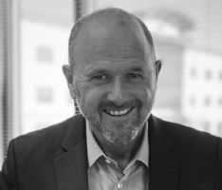


The Sargent Consulting Group, LLC
Brad Sargent
Managing Member
CPA/ABV/CFF, CFE, CCA, CFS, CIRA, CRFAC, FABFA
Jim Spencer
Director
CFE, CVA, CIRA, CCA

Slide 3
Today’s Agenda
Common Types of NFP/NP Fraud
Risk Factors
Warning Signs
Nonprofit Fraud in the News
Impact of Fraud
Fraud Deterrence Measures

Slide 4
Common NFP/NP Fraud Schemes
Embezzlement
Financial Statement Fraud
Ghost Vendor/Ghost Payroll
Kickbacks
Grant Fraud

Slide 5

Polling Question #1
Do you give money to an NFP or NP?

Slide 6
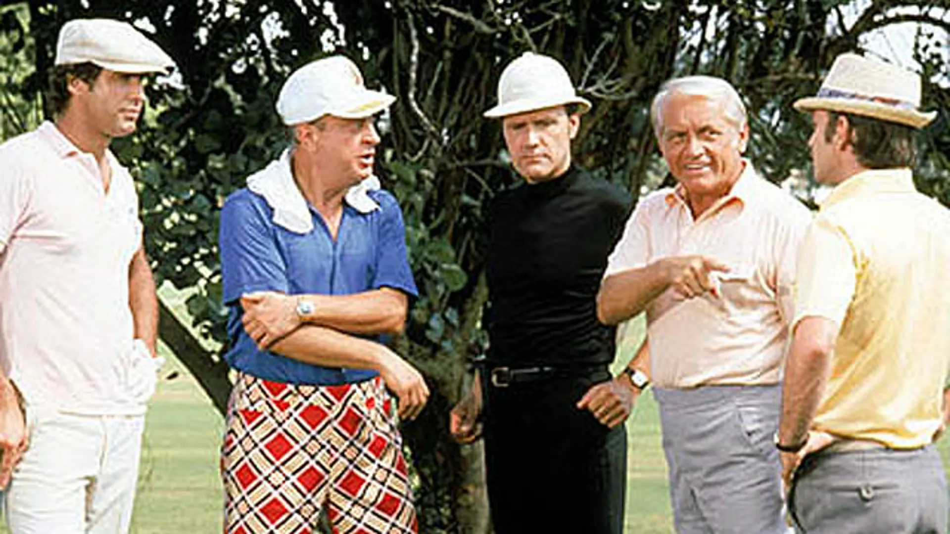
Why are NFP/NP so susceptible to Fraud?

Slide 7
Affinity Fraud
Affinity fraud is a fraudulent financial scheme that involves a scammer who is or appears to be part of a community or interest group. The scammer builds trust within the group, and exploits that trust to push fraudulent, nonexistent, and too-good-to-be-true investments on other members of the group. The members of the group rely on their trust in the scammer when they invest and take the scammer at his or her word about the investment. By the time the members recognize the scammer for the fraud he or she is, their money is gone. Frequently, victims fail to report the fraud to avoid embarrassment or because they want to handle it within the group, allowing scammers to prolong their schemes.

Slide 8
Risk Factors
The Control Environment
  Lack of Segregation of Duties
  Inadequate Oversight
  Reliance on Volunteer/Part-Time Staff
    High Turnover
  Lack of Proper Screening
    Employees & Vendors

Slide 9
Warning Signs
Unexplained financial discrepancies
Excessive/unauthorized spending
Reluctance to provide documentation
Unpleasant/combative behavior
Negative publicity or legal issues

Slide 10

Polling Question #2
Have you heard about the Detroit Riverfront Conservancy fraud?

Slide 11

Detroit Riverfront Conservancy

Slide 12
The Story of the Fraud
$100 million in expenses from 2012-2024
  Private donors and public funds
CFO allegedly stole ~$40 million in cash
  Paid $15 million in personal Amex bills
  Transferred over $24 million in funds to a personal business
Unnoticed for 12 years!

Slide 13
How Did This Happen?
CFO had SOLE control of the bank accounts
  No other person had bank password
  Staff accountant for the DRC was provided paper copies of statements four times per year
    CFO altered bank statements
CFO forged documents to open $5mm LOC
Small CPA Firm Performing Audit

Slide 14
Members of the DRC Board
CEO of Jack Entertainment
Lieutenant Governor of Michigan
CEO of the Downtown Detroit Partnership
Former Mayor of Bloomfield Hills, MI
Director of Government Affairs for Detroit
Many other NFP/NP CEOs

Slide 15
Impact of Fraud
Reputational Damage to Board Members
Legal Consequences
Reputational Damage to the Organization
Negative Impact on Donor Relationships
Harm to the Mission and/or Beneficiaries
Notes:
JBS

Slide 16

Polling Question #3
Do you currently sit on any NFP/NP Boards?

Slide 17
Fraud Deterrence Measures
The Tone at the Top
Emphasize Internal Controls
HR Process
  Due Diligence
    Employees/Volunteers
    Vendors

Slide 18
THANK YOU!
Brad Sargent
bsargent@scgforenics.com
Jim Spencer
jspencer@scgforensics.com

