Slide 1
Modern Benford’s Law
Daniel McCarville • Manager, Audit Analytics & Automation• Arch Capital

Slide 2
WE’RE HERE TO TALK ABOUT
What’s new in Benford’s Law research:
What is Benford’s Law?
What can I do with it?
What can I do when my data isn’t perfect?

Slide 3
The Basics of Benford’s Law

Slide 4
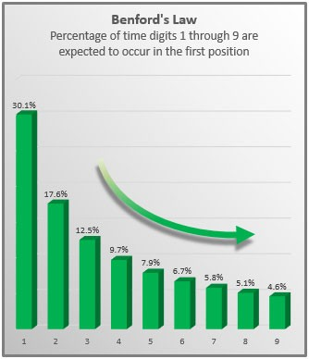
WHAT IS BENFORD’S LAW?
Number | First Significant Digit
2 | 2
$59.50 | 5
0.813548 | 8
-4,000.01 | 4
01001101 (binary) | 1
Published in the Journal of Accountancy. April 1, 2017

Slide 5
Probability(1) = log₁₀(1+ 1⁄1)
Probability(d) = log₁₀(1+ 1⁄d)
Probability(1) = log₁₀(2)
Probability(1) = 0.301

Slide 6
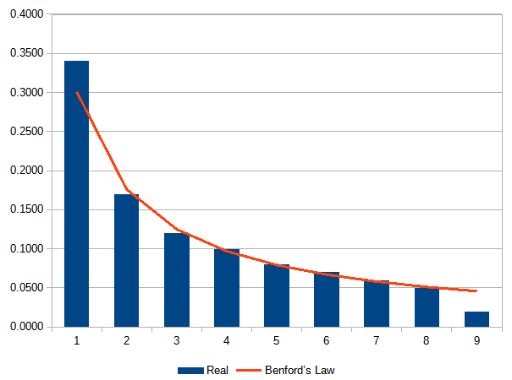
Revenue Management Scheme
Numbers are from the published financial statements of a single company over several years.
Too many 1, Too few 9.
Why?
Management unfairly rounded up revenue figures (i.e., $1 million instead of $900k).

Slide 7
WHAT KINDS OF DATA ARE BENFORD-DISTRIBUTED?
Accountancy
Income tax filings
eBay auction prices
A/R transactions
Corporate earnings
Retail returns
Auto insurance claims
Natural Sciences
Distances between planets
Weights of chemical compounds
Sizes of lakes
Greenhouse gas emissions
And more!
Populations of cities, states, and countries
Tables of statistical coefficients
Packet size in network traffic

Slide 8
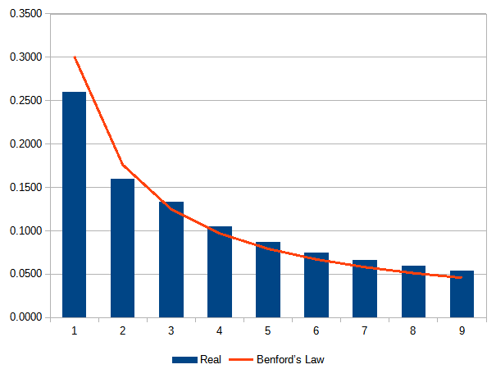
Size of Lakes
State of Alaska measures the size (size)) of lakes for wildlife & natural resource conservation.
Benford’s Law shows “missing” data in 1 and 2.
Cause: Management failed to measure small lakes - about 0.1 hectare.

Slide 9
Guidelines: Does my data follow Benford’s Law?
Yes, it does.
Unless it’s assigned, incremental values (zip codes, invoice numbers, IP addresses, etc.)
Unless there is no variation (i.e. the heights of adults measured in inches nearly always start with 5 or 6).
Just try it.
Notes:
One other area of research is the expansion of Benford’s Analysis into non-benford distributed data. I’ll focus the rest of our time here. There are a number of techniques for doing this, each with their own risks. I’ll walk through a case study based in my own research also.

Slide 10
GENERAL PURPOSE DATA QUALITY TOOL
01
Missing Data
Previously saw this with Alaskan lakes data
Typically a range of digits (i.e, 1-2, or 10-15) will be too low. All other digits slightly too high.
02
Duplication
Large spike on a single digit
03
Imprecision or Improper Rounding
Two-digit test especially helpful.
Digits like 10, 20, 30, etc. will be too high.
Sometimes people round to other amounts - like $25
04
Hard or Soft Limits (either Minimum or Maximum)
Maximum: too much right below the threshold, too little after.
Minimum: too much right after the threshold, too little below.
05
Fabricated Data
AI generated images/data show smooth curves that don’t follow Benford’s Law
Invented numbers tend toward psychological “anchor” points like 5, 10, 99, etc.

Slide 11
FRAUD OR NOT?
Every result in Benford’s Law could be the result of fraud, error, or legitimate management activity.
You need to investigate results to determine if they are legitimate or not.

Slide 12
TIPS FOR FINDING FRAUD
Understand Your Business
Identify Fraud Risks
Be Curious - and Judicious
Subject matter knowledge helps you tell the difference between legitimate business activity and fraud.
Don’t just look for “fraud”. Identify specific fraud risks and look for those particular patterns.
Any pattern could be fraud - or might not be.
Be curious about your results. Think about them - and then move on when they are no longer interesting.

Slide 13
Modern Approaches to Benford’s Law

Slide 14

GOODNESS OF FIT SCORES
Create a score which tells us how well our data fits Benford’s Law.
Objective
Precise
No ambiguity
Examples:
MAD
D Score
Notes:
Photo by Onfeed • Tech & Design on Unsplash

Slide 15
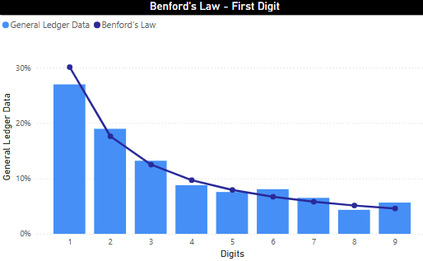
Data seems to fit moderately well. Would we conclude that it fits or not?
It’s a judgment call.
D-Score is 2.01.
The D-score has a cut-off value of 1.330.
Score is bigger than our cut-off, so it’s an anomaly.
There’s always a 5% chance of false positive.
Example - General Ledger Data

Slide 16
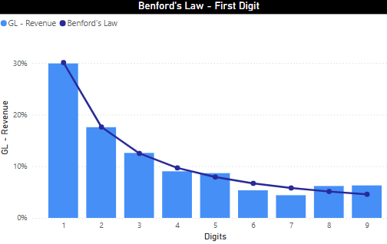
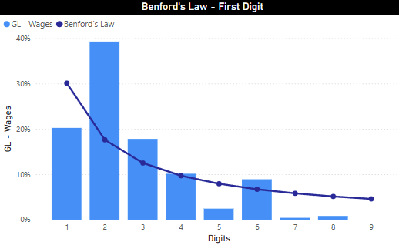
Comparison of Two GL Accounts
D = 0.87
Passes! Differences are present, but could easily be random chance. Not worth looking in to (probably).
D = 4.15
Fails! This is not Benford’s Law, and isn’t likely to be random chance.

Slide 17
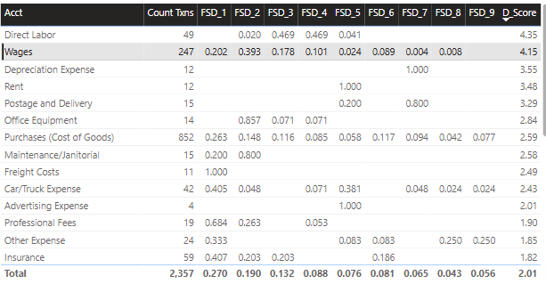
A table is a convenient way to browse accounts (or other subsets).
Include:
# of records
% of records for each digit
Resulting D score
Sort by D-score to find the highest-risk items. Focus your time on these.
Ignore items with a small number of transactions (<80).

Slide 18
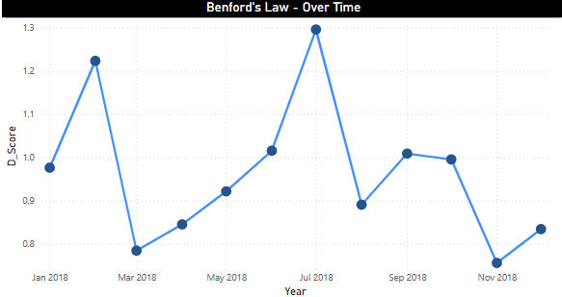
Another approach: plot changes in the D score ( or MAD) over time.
Look for peaks where the data doesn’t match Benford’s Law well.

Slide 19
When Your Data Doesn’t Follow Benford’s Law
Benford-Like Distributions
If your data is like Benford’s Law, but not quite exactly, perhaps you want to use a different kind of distribution.
Transform the Data
For larger problems, maybe you can transform your data to match Benford’s Law.
Notes:
One other area of research is the expansion of Benford’s Analysis into non-benford distributed data. I’ll focus the rest of our time here. There are a number of techniques for doing this, each with their own risks. I’ll walk through a case study based in my own research also.

Slide 20
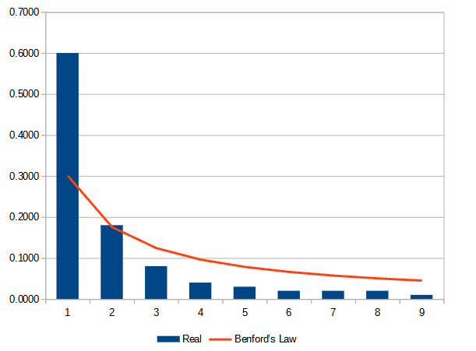
Benford-Like Data
Data:
Uncompressed Image Database
1,300 image files
JPEG coefficients
Results:
Departs from Benford’s Law
However, the overall distribution is benford-like
Published in Security, Steganography, and Watermarking of Multimedia Contents IX. (2007) Fu, Shi, and Su.
Notes:
This is an example of benford-like data. The authors were analyzing JPEG files to determine which ones had been altered. This has some useful applications in the forensic investigation of crimes, as well as intelligence. Unfortunately, the data doesn’t match benford’s law. Bummer, right?
On the other hand, that distribution does look a lot like Benford’s Law. The largest frequency is overwhelmingly at 1. Frequencies go down with each step. The shape is a steady curve, instead of a consistent drop. Over-all, pretty close.
The authors were able to tinker with the formula for Benford’s law to produce a distribution that looks almost exactly like that data. Other authors have been able to do similar kinds of things. This research is opening up Benford’s Analysis to a broader category of problems that don’t require data that exactly matches Benford’s law.
On the other hand, the data is still subject to many of our assumptions (for example, it can’t include obvious cut off points).

Slide 21
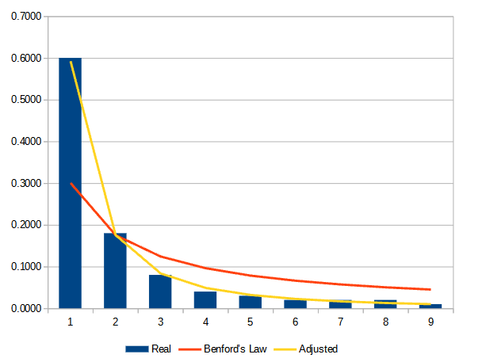
Benford-Like Data
We can tinker with the Benford’s Law formula to make this work.
Benford’s Law: log(1+ 1/d ) d is the digit
Adjusted: log(1+ 1/(s+d^{q} )) s, q are numbers we pick
Q=1.88 - Now more bendy!
S = -0.27 - Now taller!
Notes:
This is an example of benford-like data. The authors were analyzing JPEG files to determine which ones had been altered. This has some useful applications in the forensic investigation of crimes, as well as intelligence. Unfortunately, the data doesn’t match benford’s law. Bummer, right?
On the other hand, that distribution does look a lot like Benford’s Law. The largest frequency is overwhelmingly at 1. Frequencies go down with each step. The shape is a steady curve, instead of a consistent drop. Over-all, pretty close.
The authors were able to tinker with the formula for Benford’s law to produce a distribution that looks almost exactly like that data. Other authors have been able to do similar kinds of things. This research is opening up Benford’s Analysis to a broader category of problems that don’t require data that exactly matches Benford’s law.
On the other hand, the data is still subject to many of our assumptions (for example, it can’t include obvious cut off points).

Slide 22
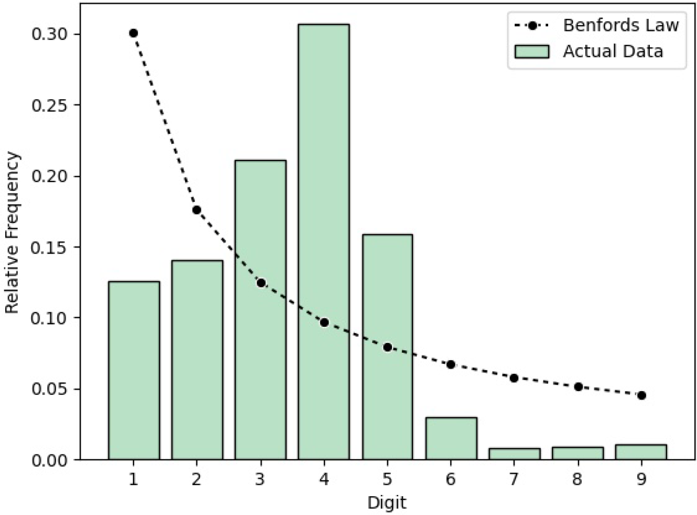
Transformation
Data:
8th grade math assessments
13,000 assessments
Results:
Departs from Benford’s law
Not benford-like
Daniel McCarville (2023). “A data transformation process for using Benford’s Law with bounded data.” Emerald Open Research
Notes:
The third approach is to transform the data into a form that will work for Benford’s analysis. Here is some data from 8th grade mathematics assessments across the country. This data comes from the University of Oregon, which is a test vendor for assessments across the country.
This data represents 13,000 assessments all taken during the same year. The data is a poor fit for Benford’s law. It isn’t even Benford-like.

Slide 23
Problem
Assessment scores run from 0 - 45. Benford’s analysis typically works best with data that ranges over many orders of magnitude.
Solution
Raise each score to the tenth power (x¹⁰).
Notes:
Why don’t the scores work well with Benford’s analysis? Well, it turns out that the assessment is designed such that the scores only exist from 0 - 45. That means there is a hard minimum and maximum. It also means that the data don’t exist over many orders of magnitude, which we would typically prefer.
Normally this would be the end of the line, but as it turns out there is a way to transform the raw scores into a form amenable to Benford’s analysis.

Slide 24
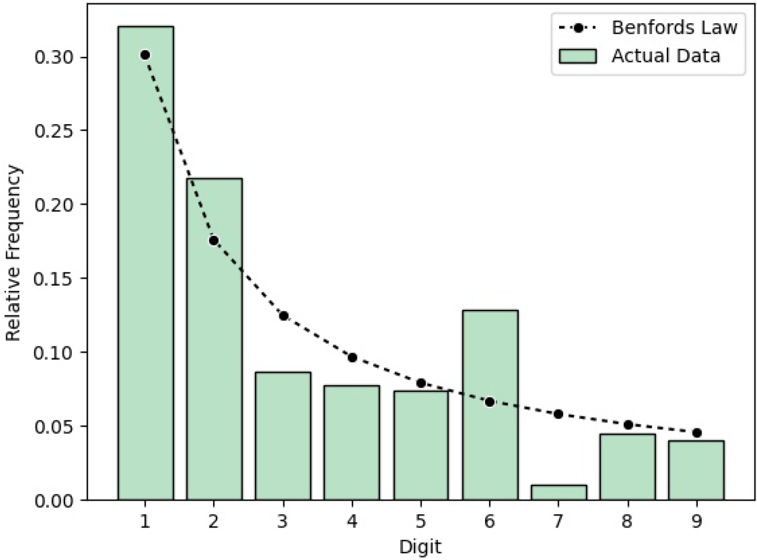
Original Data
Transformed
Notes:
Here’s the “before and after” picture. The transformation takes the whole data set and turns it into a something that looks like a Benford-distributed data set.
What can we do with this? Well, even though the aggregate data is now Benford distributed, smaller slices of the data might not be. So let’s see what the results look like if we run Benford’s analysis for each school district in the data.

Slide 25
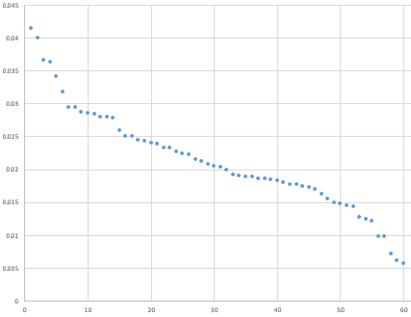
MAD Scores
by School
Notes:
Here are the results of the analysis. This was limited to school which reported at least 50 math assessments during the year. This plot shows the MAD (mean absolute deviance) for each school. The higher the number, the worse the data matches Benford’s law.
The exact score isn’t significant, but the distribution is. We can see some clear “bubbles” at the top, which indicate groups of schools with scores different than the majority of other schools. These are good audit subjects.

Slide 26

Questions?
Daniel McCarville • AVP, Audit Analytics & Automation • Arch Capital
Ask now or later
daniel.mccarville@gmail.com
Notes:
And with that, I’ll stand for questions.

