Slide 1

SAS 99 - How Auditors Think About Fraud
Smart decisions. Lasting value.™
Devin Spence
Publication date: March 2024

Slide 2

Agenda
THIS COURSE WILL DISCUSS
THESE MAIN TOPICS
1 | Intro – What you’ll learn
2 | Forensic Accounting Services
3 | Fraud 101
4 | SAS 99
5 | Fraud Brainstorming Sessions
6 | Case Study

Slide 3
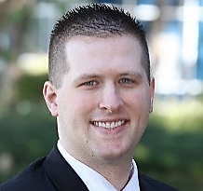
Devin Spence – CPA, CFE
Devin Spence is a member of Crowe’s Forensic Services Group with over nine years of professional experience. He has provided forensic accounting, investigative, and assurance services to clients in a variety of industries including manufacturing and distribution, healthcare, public sector, government and not-for-profit. His experience includes the analysis of sources and uses of funds and specific account activity, investigation into employee theft schemes, the design and implementation of data analytics, and the review of internal control processes.
Devin Spence
Forensic Accounting Manager
916.226.9562
devin.spence@crowe.com
Education
Bachelor of Science, Business Administration (Accounting) - California State University - Sacramento

Slide 4
Poll Question #1:
What type of fraud professional are you?
Internal Auditor
External Auditor
Investigator
Law Enforcement
Other

Slide 5

Forensic Accounting Services

Slide 6
Forensic Services Overview
Forensic experts use insights gained from extensive technical and industry knowledge to cut beneath the surface and help to uncover the real story behind the numbers. Our professionals can provide the following services:
  Forensic accounting - investigate highly complex accounting transactions, leveraging forensic technologies and our legal management consulting background.
  Digital forensics and incident response - help recover valuable intellectual property.
  E-discovery - resolve complex data and information challenges for investigations and litigation.
  Insurance claims preparations - help maximize insurance recoveries and assist with the preparation of a comprehensive insurance claim package.
  Post-acquisition disputes and arbitration support - help defend working capital and earnout positions based on the agreement framework during settlement discussions and arbitration proceedings or serve as an impartial party to navigate disputes.

Slide 7
Forensic Capabilities
Investigate allegations of asset theft, corruption and fraudulent financial reporting.
Examine and respond to potential regulatory or legal compliance .
Analyze potential breaches of contract, fiduciary trust, ethics or internal policy.
Analyze processes, data or documentary support for potential instances of fraud, non-compliance or other organizational risks.
Identify ways to mitigate fraud exposure at your organization.
Conduct fact-finding and/or suspect interviews.
Perform background and asset searches.
Reconstruct financial records and preserve, recover and analyze digital evidence.
Prepare and present oral or written reports of findings and recommendations.

Slide 8
Independent Investigation Steps
  Independent Investigation Process
  Preliminary Fact-Finding :
    Establish reporting methods and relationships for the engagement duration.
    Confirm project deliverables and expected timing.
    Describe the structure of your organization, including key positions and job responsibilities.
    Identify appropriate individuals to provide documentary support for the project.
  Information Gathering:
    Conduct interviews of personnel with a direct knowledge of the key business processes, policies, systems, and internal controls.
    Examine all reports, timelines, workpapers, supporting documentation or other relevant records identified to research the issues at hand.
  Analysis:
    Examine relevant supporting documentations.
    Identify trends, patterns, unusual/suspicious transactions, and other anomalies.
  Reporting:
    Summarize observations and findings.

Slide 9
Fraud 101

Slide 10
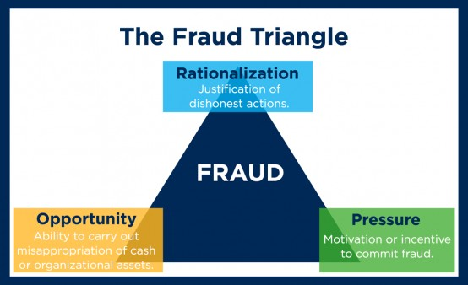
Motivations to Commit Fraud
“Managing the Business Risk of Fraud: A Practical Guide” :
  “Any intentional act or omission designed to deceive others, resulting in the victim suffering a loss and/or perpetrator achieving a gain.”

Slide 11
Post-COVID Considerations
Rationalization
  I am working harder and keeping the company alive – obviously, I deserve more.
  I have additional costs at home – I deserve more.
  We have never failed debt covenants before – we are not reporting failure today which will cost us enormous amount of time – we will be fine, the bank is not at risk.
  We didn’t get government incentive like others – we will adjust our government contracts.
  I am a parent, teacher, principal, income winner, etc. – I deserve more.
Incentive
  Corporate income may be down causing debt compliance issues, changes to incentive compensation plans, stock price impact, goodwill impairments.
  Individuals who are employed are struggling to balance all their demands.
  Individuals may have more responsibilities at work – less employees.
  Individuals may have compensation impact.
Opportunity
  Less employees – lack of segregation of duties.
  Less face-to-face time – may be easier to hide.
  Approvals via emails – more hacking of emails and easy to alter emails.
  Weak control environment before – likely weaker today.
  Firewalls have been taken down due to work from home policies – greater outside access.

Slide 12
Categories of Occupational Fraud
Asset misappropriation (86% of known fraud cases and least costly fraud):
An employee or official steals or misuses the organization’s resources (e.g., theft of company cash, false billing schemes or inflated expense reports).
Corruption (50% of known fraud cases):
An employee or official misuses his or her influence in a business transaction in a way that violates his or her duty to the employer in order to gain a direct or indirect benefit (e.g., schemes involving bribery or conflicts of interest).
Financial statement fraud (10% of known fraud cases and most costly fraud):
An employee or official intentionally causes a misstatement or omission of material information in the organization’s financial reports (e.g., recording fictitious revenues, understating reported expenses or artificially inflating reported assets).
Source: 2022 ACFE Report to the Nations on Occupational Fraud and Abuse

Slide 13
Poll Question #2:
Have you ever identified fraud?
Yes
No

Slide 14
SAS 99 - Consideration of Fraud in a Financial Statement Audit

Slide 15
What is SAS 99?
The guidance was issued by the Auditing Standards Board (ASB) of the American Institute of Certified Public Accountants (AICPA).
Provides auditors with specific requirements and guidance on how to address the risk of fraud during a financial statement audit.
SAS 99 requires:
  auditors to understand and assess the risk of material misstatement due to fraud, including both fraudulent financial reporting and misappropriation of assets.
  brainstorming sessions to identify potential fraud risks, evaluating the results of those sessions, and responding to identified risks.
  auditors to communicate with management and those charged with governance about fraud risks, including any identified instances of fraud.
  auditors to respond to identified fraud risks, including modifying the audit approach and performing additional procedures if necessary.

Slide 16
What is SAS 99? Continued.
SAS 99 emphasizes:
  the need for auditors to obtain and document information about fraud risks and responses to those risks;
  the importance of auditors maintaining professional skepticism and exercising professional judgment throughout the audit process;
  the importance of maintaining professional skepticism when evaluating audit evidence and considering the possibility of fraud; and
  the importance of considering the potential for management override of controls and the need to test controls designed to prevent or detect fraud.

Slide 17
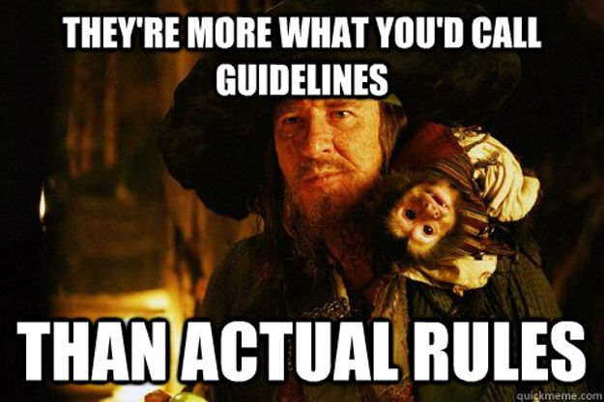
SAS 99 - Summary
Auditors:
gather information needed to identify risks of material misstatement due to fraud;
Assess the risks after taking into account an evaluation of the entity’s programs and controls; and
Respond to the results.

Slide 18
Fraud Brainstorming Sessions

Slide 19
Fraud Brainstorming Purpose
According to the Journal of Accountancy, there are two purposes of the brainstorming session:
The first is strategic in nature, so the engagement team will have a good understanding of information that seasoned team members have about their experiences with the client and how a fraud might be perpetrated and concealed.
The second objective of the session is to set the proper “tone at the top” for conducting the engagement.

Slide 20
Poll Question #3:
All the following are rules that should be followed during a brainstorming session, except what?
No ideas or questions are dumb
No one “owns” ideas
No excessive note-taking
Ideas from more experienced individuals are more important

Slide 21
Poll Question #3 - Answer:
D. Ideas from more experienced individuals are more important

Slide 22
Fraud Brainstorming Session Discussion Points
Understand the business, strategic goals, and major company / industry trends of events (potential IPO or SPAC, merger/acquisition, impaired growth, economic downturn, other factors etc.) .
Understand the company structure .
Understand the current risks identified.
  Management Override of Controls
  Revenue Recognition
  Estimates
Understand if there are any past deficiencies or fraud.
Understand the recent changes.
Enhance fraud inquiry questions.
Notes:
General Steps – Understanding the Entity Gain understanding of business, strategic goals, and major company / industry trends of events (potential IPO or SPAC, merger/acquisition, impaired growth, economic downturn, other factors etc.)
Gain understanding of company structure C-suite - tenure, ownership, capabilities, relationships Foreign operations –
FCPA issues? Is there a compliance program in place? Compensation packages Bonuses Metric based incentives
Accounting department
How large?
Segregation of duties issues? (review and approval)
IT Structure Key systems for reporting (follow up as needed. More questions if using systems with weak controls like QuickBooks – is user ID tracking turned on, etc.)
Segregation of duties (admin access)
Is there an internal audit team? Are they active and does our audit team meet regularly with them? What are their priorities and capabilities?
Have background checks been performed on key individuals If so, any concerns? If not, who should have a background check done on them?
If you were to commit fraud, how would you do it?
Gain understanding of current risks identified by the audit team (Risk Accumulator)
Management override of controls (Always a risk)
Revenue recognition (Almost always a risk, some financial institutions/broker dealers and pre-revenue entities don’t have this risk) “Fraudulent revenue recognition” is most likely insufficient for auditors to be able to design an effective audit response to address the risk. Needs to be specific.
Estimates or decisions requiring judgement (a retrospective review should be performed to determine whether there are indications of possible bias in the development of accounting estimates)
Others?
Gain understanding of any past deficiencies or fraud
Have deficiencies been remedied?
How were they handled by management (Tone at the top?)
Is there a whistleblower hotline? (Code of Ethics for Employees is available and sufficient?) Is it tested?
What is the nature of the calls coming through the hotline?
Gain understanding of recent changes Headcount changes, remote work issues, etc. Turnover of officers, accounting or IT staff, other key roles Ask the audit team about
Fraud Inquiry Questions Suggestions: Ask open ended questions that require more than a "yes" or "no" answer. Ask about what they like and dislike about their duties and responsibilities. Ask about their workload. Is it manageable? Think about who do you have inquiries with. Have you thought about having the inquiries with others? At different levels and departments? Examples: What are the challenges to performing your daily work? When is the work more stressful? What would make things easier / better? How does management support you?

Slide 23
Professional Skepticism
The auditor must maintain a questioning mind and critically assess the responses from the reporting entity’s management and other evidence examined to determine the risk or existence of fraudulent misstatements.
Old Auditor Motto: Trust, but Verify.
New Way: Never Trust, Always Verify.

Slide 24
Case Studies

Slide 25
Case Study – Tone at the Top; Bid Rigging/Tailoring
Client: Higher Education Institution
Issue: Whistleblower complaint about how the president of the institution was influencing bids. They also had a domineering style of leadership and bulldozed anyone who voiced opposition.
Results: President was put on administrative leave for 2 weeks but was brought back as the matter was initially determined to be just an HR matter. An independent investigator was hired. Five months later the president was terminated. Once the former president was removed, a clear change in the culture occurred and more employees came forward.
Notes:
Whistleblower complaint came through the entity’s hotline about the president.
Internal Audit received and reviewed the complaint.
IA had a direct report to the president.
IA had a dotted line report to the board.
The complaint was related to a procurement issue of bid rigging.
The president set an unusually high price for the bid
Setting bid prices is out of the norm.
Consultants were brought in to write the RFP.
The entity did not have experience with this type of work.
The consultants who wrote the RFP bid on the RFP and ultimately won the work. (Bid Rigging/Tailoring)
The president had previous involvement with the consultants.
The president was very pushy (domineering attitude), and he shut down anyone putting up resistance to their ideas.
The president didn’t have a lot IT access, but his direct reports did. If the president wanted something done, it got done.

Slide 26
Case Study – Lack of Segregation of Duties
Client: Retail Dealership
Issue: A family business was run by a father who passes away. The son takes over as General Manager, and one sister takes over as CFO. The brother gets suspicious of CFO sister when their cashflow is not matching their sales volume and the sister is taking expensive vacations.
Results: Sister was doubling the payroll payments. First payment would go to payroll provider for all the employees and a second payment for the same amount would go into her personal bank account. Sister was fired, no charges were filed as the auto dealership didn’t want their vendors and customers to know about the fraud. Twist – A second sister (receptionist) wrote-off her boyfriend’s auto loan during the investigation.

Slide 27
Case Study – Management Override
Client: Media Company
Issue: Vendors contacted the company stating they had not been paid in several months. An executive said it was due to the timing of funding coming in from the parent company.
Results: The executive hadn’t paid bills because their bank account was overdrawn by over $700,000. We found that the executive had used his corporate cards for personal expenses and had the company pay for his personal credit card bill. He would tell the accountant to book his personal expenses as business expenses. The accountant never asked questions. Accounting records were not reviewed by the parent company. Credit card statements were never reconciled. The parent company ended up covering all the costs to avoid litigation with the vendors.
Notes:
Other issues:
CC Payments were booked as Assets
The executive received Pay advances

Slide 28

Questions

Slide 29

Devin Spence
Forensic Accounting Manager
1.916.266.9562
devin.spence@crowe.com

